Slide 1
Instagram User Analytics
-Akshay Kumar Goud Sowdari

Slide 2
Project Description
Our end goal is to discover valuable insights and behavioral patterns from data, to meet this requirements we’re going utilize MySQL. By doing so, we aim to provide helpful insights that benefit different teams within the organization.
Throughout the project, we’re going to find insights on users such as most loyal users, inactive users, bots and fake accounts. Also we’re gonna find most used hashtags, most liked photos etc.,
User analytics typically refers to the analysis of user behavior and data to gain insights into user preferences, habits, and patterns.
Teams across the organization such as marketing, product & development, leverage these insights to accomplish several tasks such as launching a new marketing campaign, deciding on the features to build for an app, measuring user engagement to track the app's success, and enhancing the user experience, which contributes to the growth of the business.

Slide 3
Approach
MySQL schema has been designed with appropriate primary-foreign key relationships, and all necessary tables have been created and populated with data. The data has undergone cleaning procedures to ensure it is prepared for analysis. To obtain useful insights from the data, a series of SQL queries have been executed.

Slide 4
Tech - Stack Used
MySQL 8.0.32
MySQL is a powerful and widely-used open-source Relational Database Management System (RDBMS). I’ve specifically chose MySQL to build database because of its affordability, scalability, reliability, performance, security, flexibility, and compatibility with other technologies, which made it the best-suited option for my project.

Slide 5
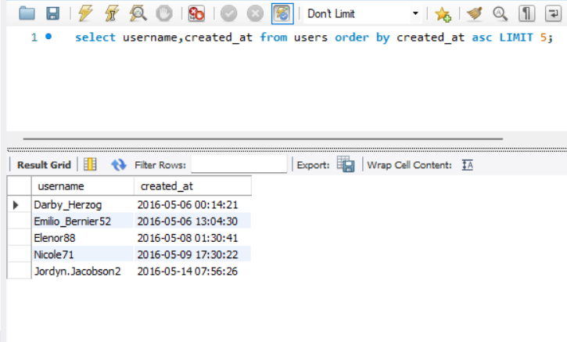
Insights
A) Marketing: The marketing team wants to launch some campaigns, as part of this process and they requested us to provide insights.
Rewarding Most Loyal Users - Marketing team wants to reward most loyal users, hence they asked us to find 5 oldest users. Five most loyal users are-
Darby_Harzog
Emilio_Bernier52
Elenor88
Nicole71
Jordyn.Jacobson2

Slide 6
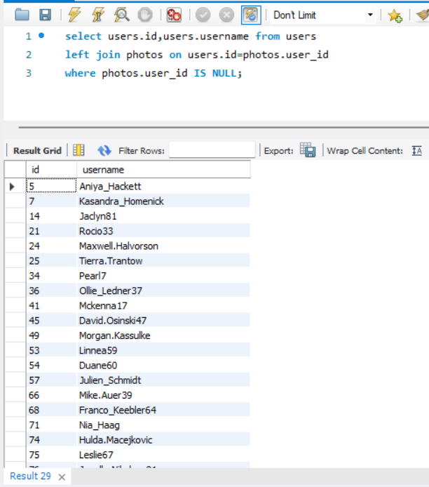
Remind Inactive Users to Start Posting: Marketing teams wants send promotional emails to post their first photo to inactive users. Here’s the list of users who have never posted a single photo on Instagram
ID Username
5 Aniya_Hackett
7 Kasandra_Homenick
14 Jaclyn81
21 Rocio33
24 Maxwell.Halvorson
25 Tierra.Trantow
34 Pearl7
36 Ollie_Ledner37
41 Mckenna17
45 David.Osinski47
49 Morgan.Kassulke
53 Linnea59
54 Duane60
57 Julien_Schmidt
66 Mike.Auer39
68 Franco_Keebler64
71 Nia_Haag
74 Hulda.Macejkovic
75 Leslie67
76 Janelle.Nikolaus81
80 Darby_Herzog
81 Esther.Zulauf61
83 Bartholome.Bernhard
89 Jessyca_West
90 Esmeralda.Mraz57
91 Bethany20

Slide 7
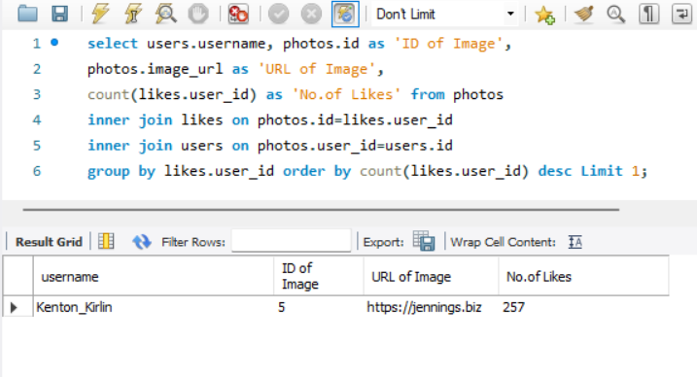
Declaring Contest Winner: The team started a contest and the user who gets the most likes on a single photo will win the contest now they wish to declare the winner. And the username of the winner is -
And the username of the winner is -
Kenton_Kirlin
ID of Image : 5
Image URL : https://jennings.biz
Total No.of Likes : 257

Slide 8
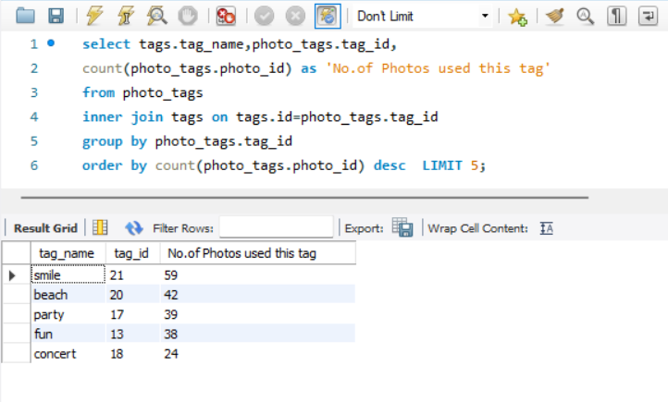
Hashtag Researching: A partner brand wants to know, which hashtags to use in the post to reach the most people on the platform.
Here’s the list of top 5 most commonly used hashtags
smile ( tag ID-21) : 59 photos used this tag
beach ( tag ID-20) : 42 photos used this tag
party ( tag ID-17) : 39 photos used this tag
fun ( tag ID-13) : 38 photos used this tag
concert ( tag ID-18) : 24 photos used this tag

Slide 9
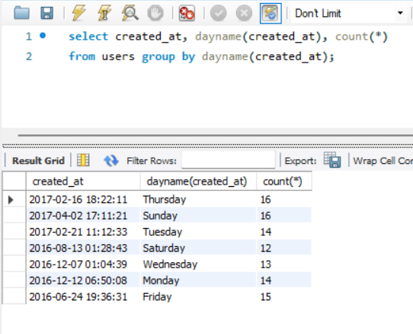
Launch AD Campaign : The team wants to know, which day would be the best day to launch ADs.
Both Thursday and Sunday are suitable for ad campaigns as most users registered on both of these days.

Slide 10
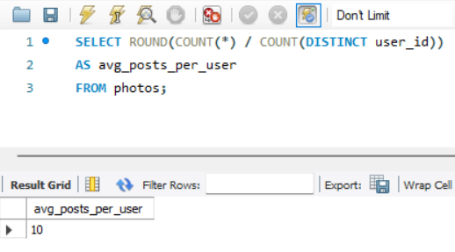
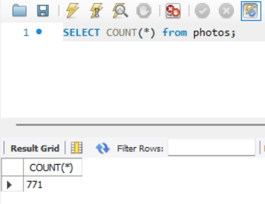
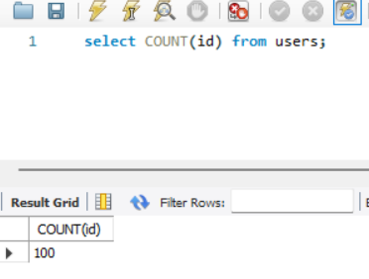
B) Investor Metrics: Investors want to know if Instagram is performing well and is not becoming redundant like Facebook, they want to assess the app on the following grounds -
User Engagement: Are users still as active and post on Instagram or they are making fewer posts To assess the user engagement we’re tasked to provide how many times does average user posts on Instagram. Also, provide the total number of photos on Instagram/total number of users
No.of times an average user posts on Instagram - 10
total number of photos on Instagram - 771
total number of users - 100

Slide 11
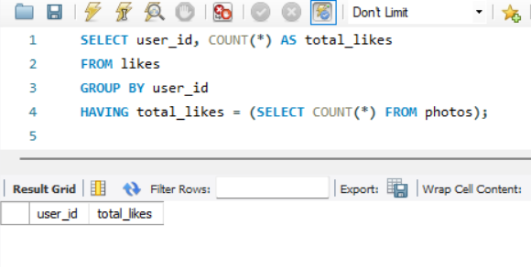
Bots & Fake Accounts: The investors want to know if the platform is crowded with fake and dummy accounts We’re tasked to provide data on users (bots) who have liked every single photo on the site (since any normal user would not be able to do this).
After Analysis, it is found that there are No bots & Fake Accounts on Instagram

Slide 12
Results
During the process of creating this project, I have gained valuable insights into the handling of real-life data and the effective ways in which social media applications interact with their audience. This project has enhanced my understanding of the significance of data and its impact on diverse teams within an organization, including the marketing team. Additionally, I have learned about the types of information that are of interest to investors. This project has expanded my knowledge on creating database schemas, refining data for analysis, and utilizing SQL queries to extract valuable insights from data.

